Slide 1
Module 3:
Getting Products To Market
Shipping & Logistics and The
Benefits of Using A Customs Broker.
Presenter: Kerick Farquharson
Customs Broker
November 12, 2015

Slide 2
Shipping
Shipping is the physical process of transporting commodities and merchandise goods and cargo via sea or air to include multi modal arrangement.
Shipping Processes- Three Stages
a. Pre- Transport
b. Transport
c. Post transport.

Slide 3
Logistics
Logistics is the management of the supply chain in the flow of goods between the point of origin and the point of consumption in order to meet market demands (and optimize legitimate returns).

Slide 4
Choosing a Suitable Carrier
This is dependent upon:
The shipper’s particular needs.
Availability of options.
Options:
Sea
Air
Multimodal (which includes Transshipment)

Slide 5
Other Considerations
Frequency of Service
Transit Time
Inland Transport
Transshipment Possibilities
Shelf Life of the Product: (type of goods, perishable/ processed, cooling/ freezing requirements).
Location of Market

Slide 6
Shipping & Logistics
Documentation:
Origin and Destination including In Transit via another Country.
Bill of Lading (ORIGINAL)/Air Waybill
Commercial Invoice
Packing List
Marine Insurance Certificate (Unless Shipped At Shipper’s Risk/ Buyer’s Risk)
License/ Permits/ Certification Required by Exporting/ Importing Country.
Certificate of Origin – especially as it might imply Duty Concessions e.g., CARICOM or other International Trade Agreements.

Slide 7
Legal Aspects of Shipping.
Matters To Consider:
1. Terms of the Bill of Lading
Definition- Bill of Lading – (B/L or BOL) is a document issued by a carrier which details a shipment of merchandise and gives title of that shipment to a specified party.

Slide 8
Terms of the Air Waybill
Definition- Air Waybill is a document made out by or on behalf of the shipper which evidences the contract between the shipper and the carrier for carriage of goods over route or routes of the carrier.

Slide 9
Terms of Multimodal Bill of Lading
A Multimodal Bill of Lading is a Bill of Lading which allows or verifies the movement of goods using various modes of transport e.g. rail, truck, sea, air.

Slide 10
Pro-forma/ Commercial Invoice
A pro-forma invoice (or estimated invoice) is the document commonly used as preliminary invoices with a quotation
Estimated invoice sent by a seller to a buyer in advance of a shipment or delivery of goods which shows the negotiation reached between the seller and the buyer.
It notes the kind and quantity of goods, their value, weight, transportation charges, terms of sale and terms of delivery.
A pro-forma invoice is not a confirmation of a Sales Agreement.
It does not dictate payment of goods.
Customs will not use this invoice as the basis of arriving at Value of Goods for calculation of Duties & Taxes.

Slide 11
Commercial Invoice
Document issued by seller to confirm that a sale actually took place.
Required by Customs to determine the correct value of goods for the purpose of assessment of duties and taxes.
It must identify buyer and seller.

Slide 12
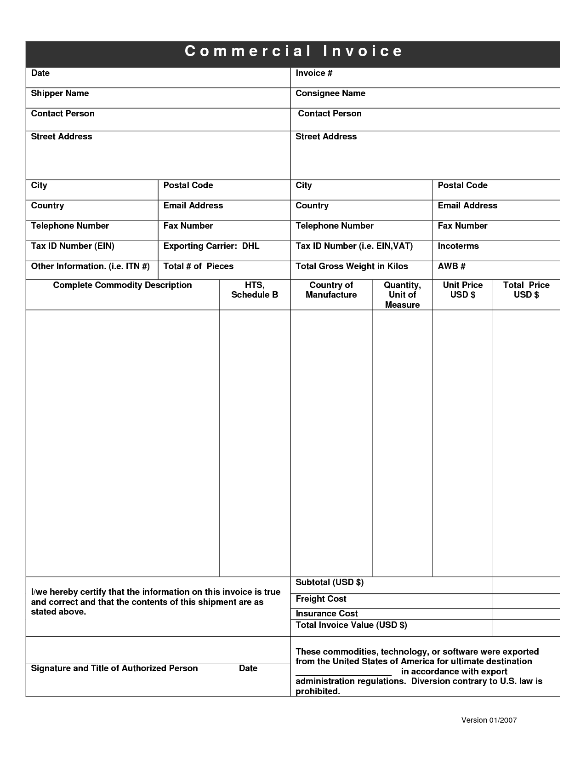

Slide 13
Mandatory Properties of Commercial Invoice
Terms of Sale
Quantity/ Weight and or Volume
Type of Packaging
Final Destination of Goods
Unit Value/ Total Value
Insurance/ Inland Charges/ Shipping Charges
Packaging + Handling Fees
A Commercial Invoice must be prepared in the appropriate Language.

Slide 14
Terms of Sale
COD/ Cash on Delivery
Credit
a. Terms of Credit
b. Interest Rate Issues

Slide 15
Terms of Delivery
INCOTERMS
A Global standardized set of terms intended to reduce or remove altogether uncertainties arising from different interpretation of the rules in different countries for the movement of goods and where the responsibility/ liability change hands from the seller to the buyer.
Ex- Works VS DDP

Slide 16
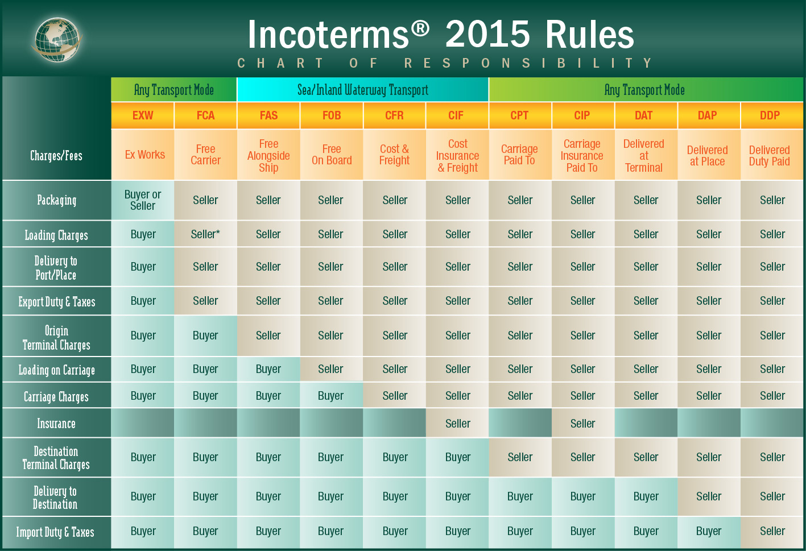

Slide 17
Costing Considerations
Origin Cost (Jamaica)
Cost of Goods
Inland Transport
Export Processing
Port/Airline Fees
Consolidation
Warehousing
Marine Insurance
Freight (Air or Sea)
Destination Cost
Transshipment Inspection
Terminal Handling
Customs Clearance
Storage/ Demurrage etc
Customs Duty/ Taxes
Inland Haulage
Warehousing
Distributor’s Mark- Up

Slide 18
Role of the Customs Broker
Section 144 of the Customs Regulations “Customs Broker means a person, other than a ship’s agent licensed under these Regulations to transact on behalf of a client customs business with the Customs including the entering of goods of all descriptions under the customs laws”.

Slide 19
Role of the Customs Broker
Legal Mandate
A licensed Customs Broker must be a person of good character and is otherwise a fit and proper person to act. (INTEGRITY)
A Customs Broker must have the requisite knowledge and competence to act.
a. Knowing
b. Knowing Who Knows

Slide 20
Recommendation.
All exporters/ importers can benefit from aligning themselves and businesses to a competent licensed Customs Broker.
Scenarios Discussed

Slide 21
Contact Information
Kerick Farquharson (Customs Broker )
Lot 5 Fairfield Estates Bogue,
Montego Bay, Jamaica.
Telephone: 971-9780
874-9122
Email: cust519@cwjamaica.com

